Slide 1
Jaya optimization algorithm with GPU acceleration
Jimeno-Morenilla, A.; Jimeno-Morenilla, A; Sánchez-Romero, J. L; Migallón, H; Mora-Mora, H
Adam Stock 15034312

Slide 2
The Jaya algorithm
An optimization algorithm
Aims to find the optimal value for a function
Maximum size
Minimum resources
Parameter-less
Does not require parameter ‘tuning’
Improper tuning can mean
Local minima not global solution
Increase computational effort
Notes:
What is the jaya algorithm

Slide 3
Deterministic
With large problems or certain data sets this can become a very complex and expensive task
Heuristic
Often more flexible
Often more efficient
Evolutionary algorithms
Swarm intelligence algorithms
Genetic algorithms
Differential evolution
Partial Swarm optimisation
Artificial Bee Colony

Slide 4
The Jaya algorithm
Previous iteration
These dictate how strongly to move
$${X′}_{j,k,i }= X_{j,k,i }+ r_{1,j,i} \left(X_{j, best, i}−\left|X_{j,k,i}\right|\right)− r_{2,j,i}\left(X_{j, worst, i}−\left|X_{j,k,i}\right|\right)$$
Next iteration
What to move towards/away from
$X_{j,k,i }$ = Value of the j_{th} variable of the k_{th} candidate during the i_{th} iteration
Notes:
Due to the reuse of Xjki there will be some blocking/synchronisation

Slide 5
$${X′}_{j,k,i }= X_{j,k,i }+ r_{1,j,i} \left(X_{j, best, i}−\left|X_{j,k,i}\right|\right)− r_{2,j,i}\left(X_{j, worst, i}−\left|X_{j,k,i}\right|\right)$$
$X_{j,k,i }$ = Value of the j_{th} variable of the k_{th} candidate during the i_{th} iteration
The new candidate is only accepted if it provides a better function evaluation
They become the input to the next iteration
This can be parallelised due to the algorithm being relatively easy to break into simple numerical processes
Split –
Each individual can be evaluated separately
Each variable can produce a value with only the best and worst needing to be used

Slide 6

GPGPU
General purpose computing on a graphics processing unit
CUDA allows for access to the hardware commonly used for graphics rendering.
Graphic's processing often entails performing the same calculation on multiple data
Proprietary to Nvidia hardware

Slide 7
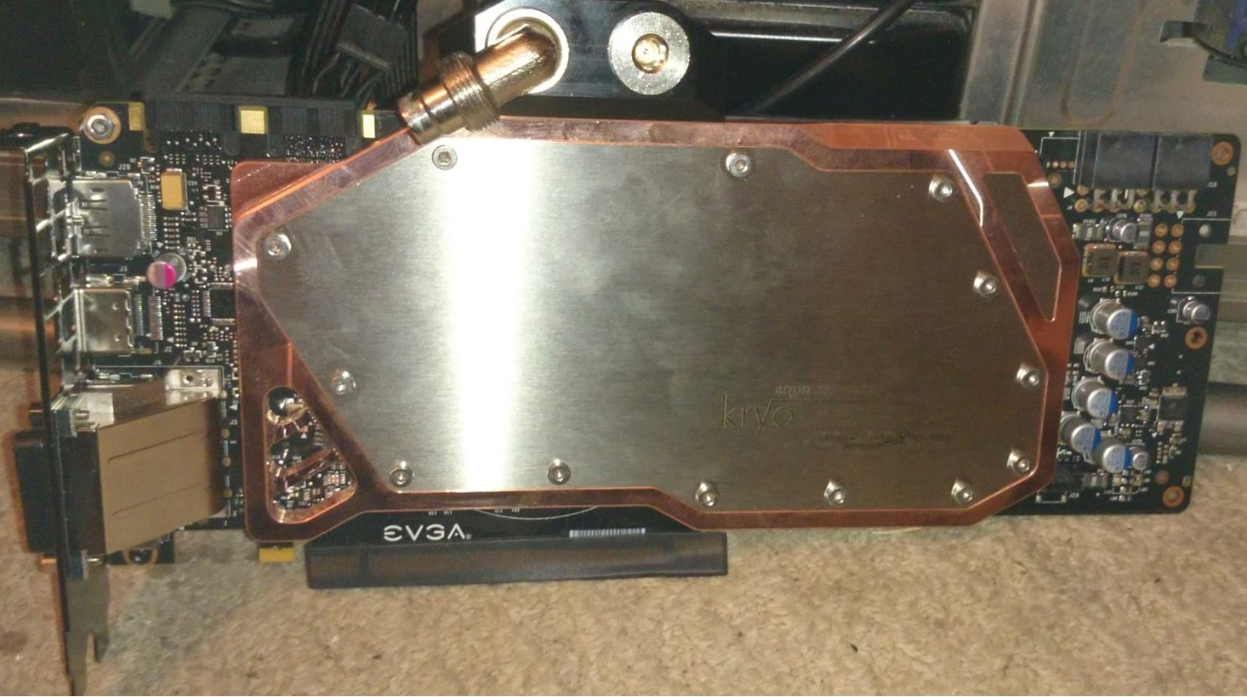
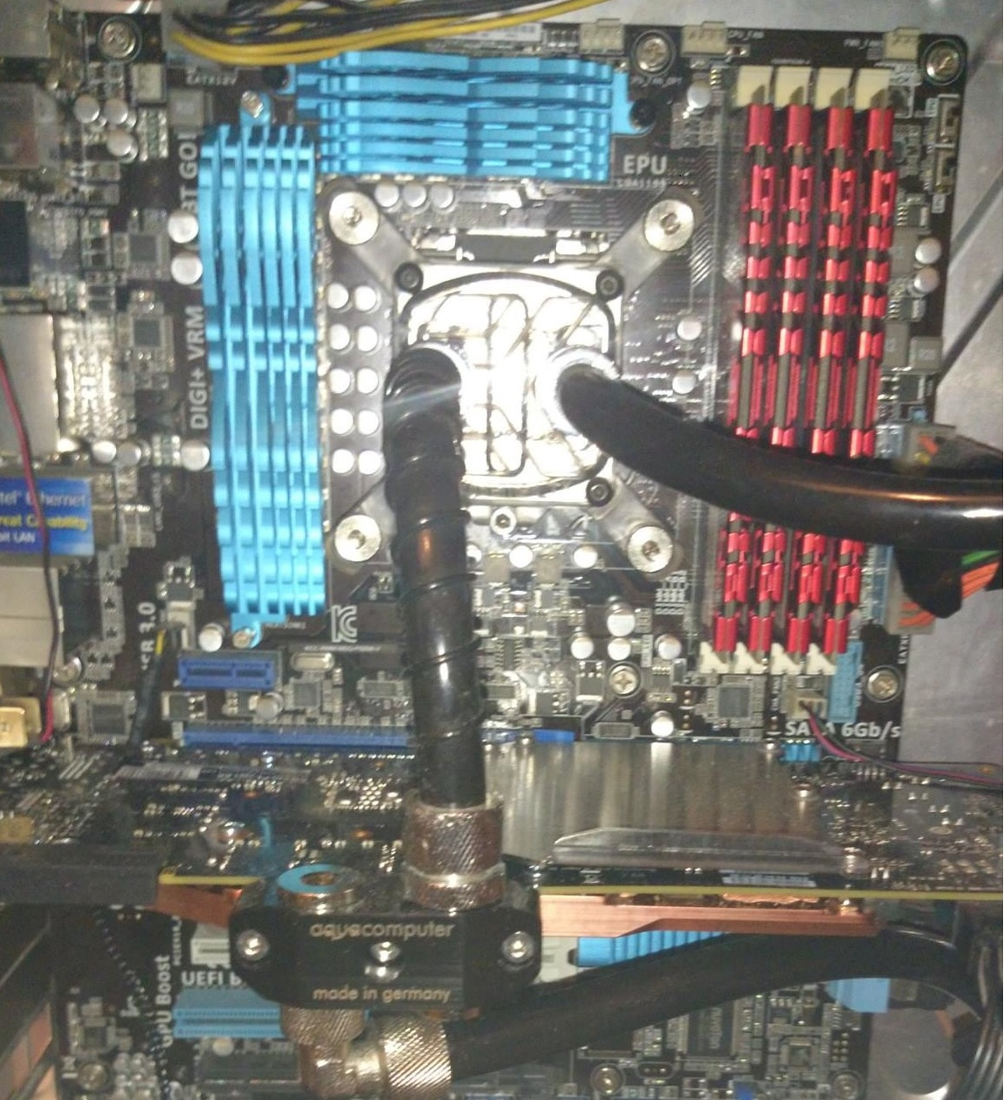
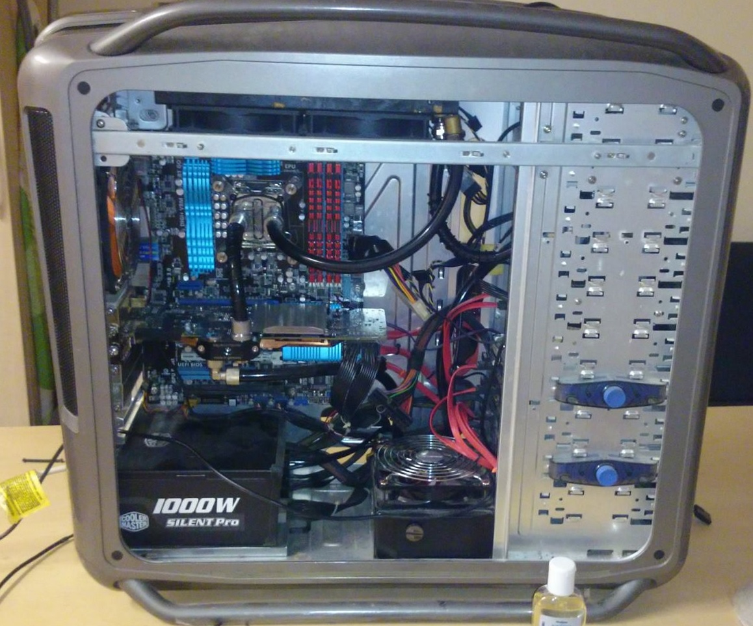
Notes:
In this case they are using a Maxwell based gpu – like my own

Slide 8
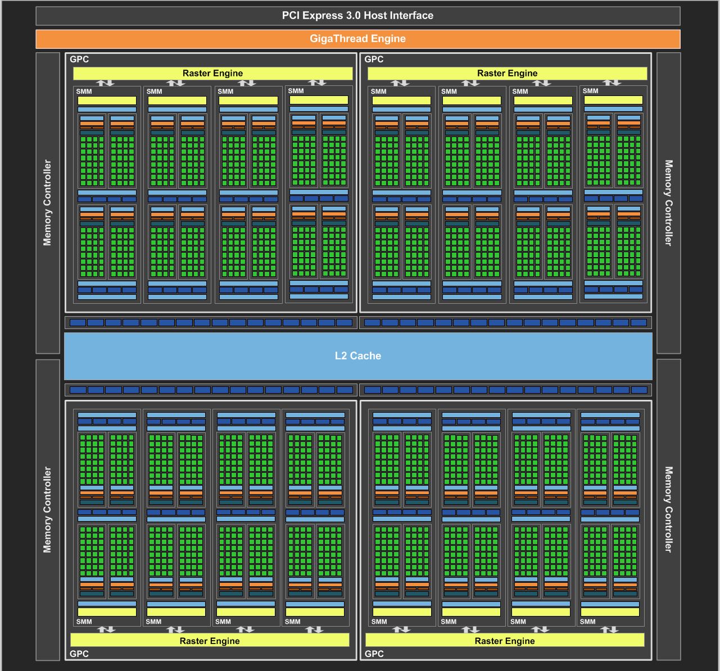
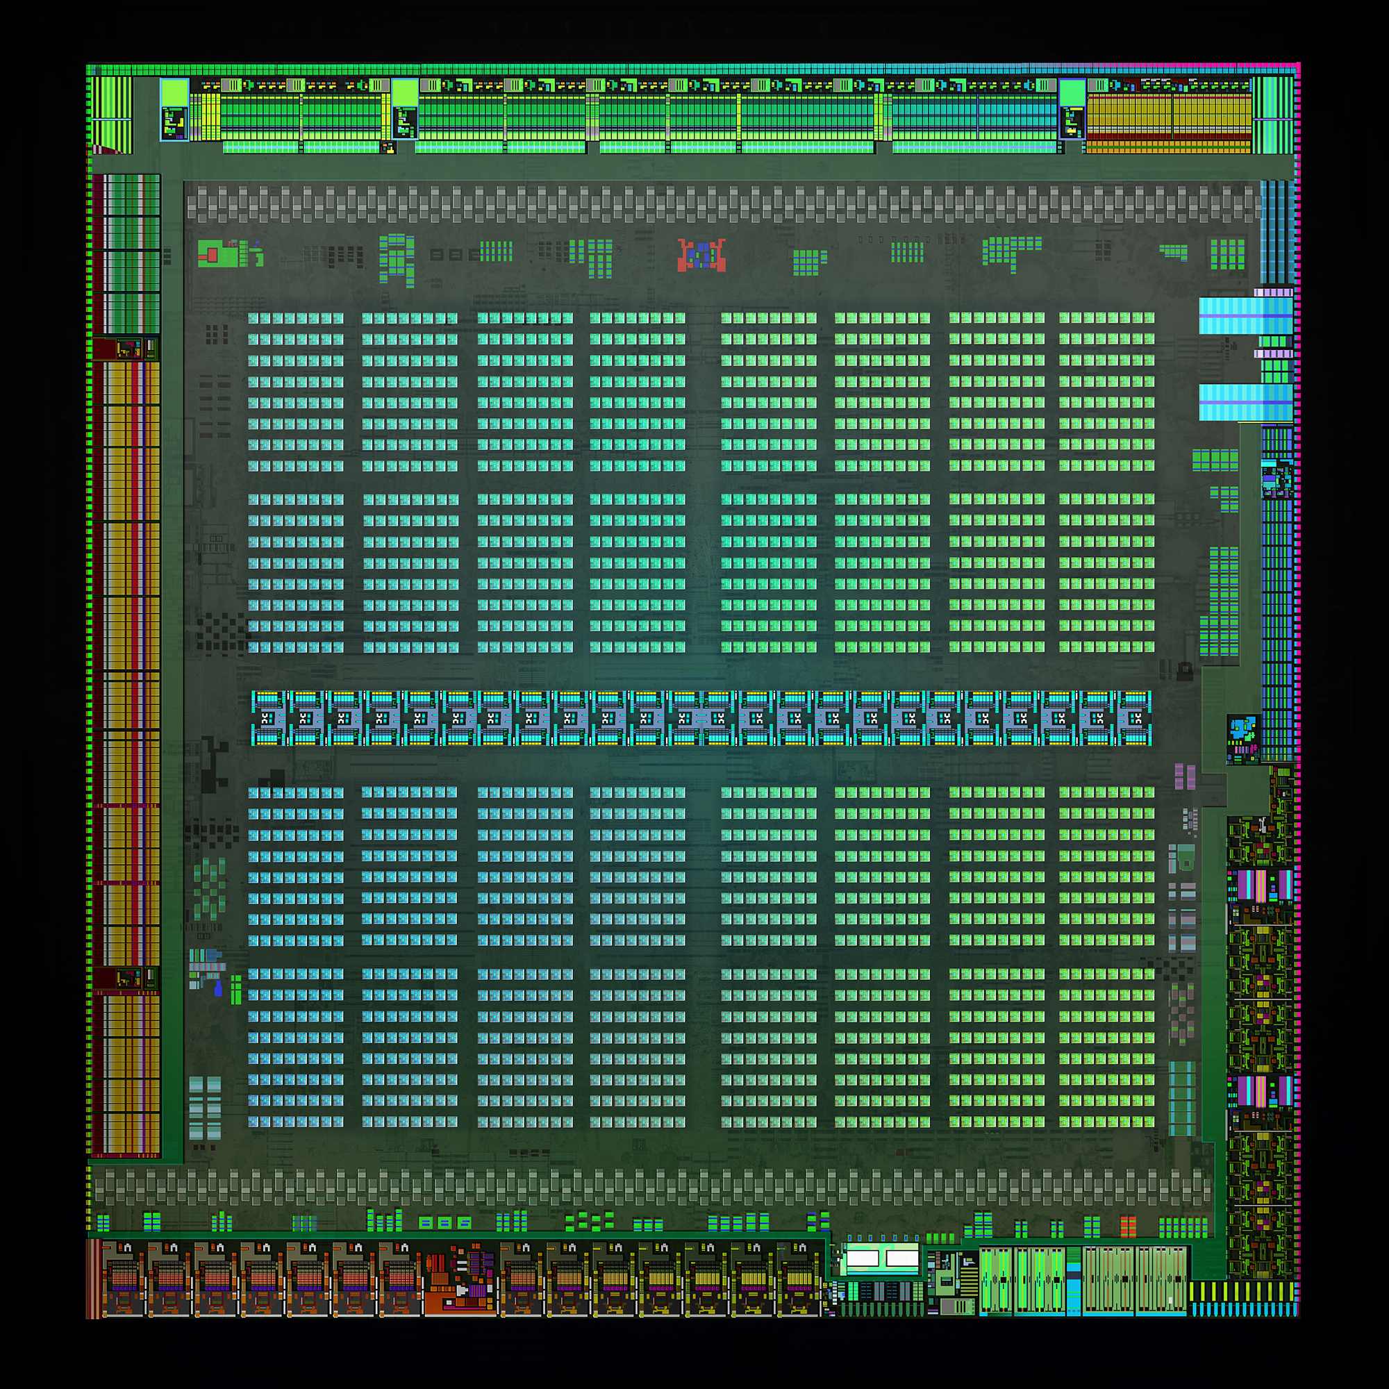
Notes:
This is the architecture ……. The die looks very similar to the block diagram , it is difficult to bring attention to such a small piece of the diagram so ….. Giant red arrow

Slide 9
First attempts –
Single CUDA core – single CUDA thread
Population size less than several hundred
Nvidia architecture fixed set of compute units
Not enough to keep the GPU fed with tasks
Add parallelism contained in the functions

Slide 10
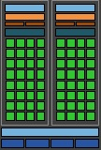
Memory shared
Map each to a single SMM
Keeps efficiency
If threads were split blocking and synchronisation issues may occur when fetching data

Slide 11
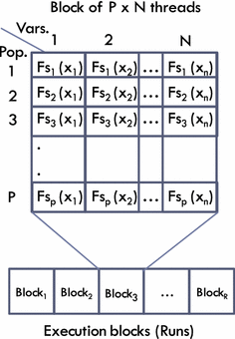
P = population size (k)
N = design variables for a function (j)
Blocks = iteration / run (i)
$${X′}_{j,k,i }= X_{j,k,i }+ r_{1,j,i} \left(X_{j, best, i}−\left|X_{j,k,i}\right|\right)− r_{2,j,i}\left(X_{j, worst, i}−\left|X_{j,k,i}\right|\right)$$

Slide 12
Hardware –
Nvidia GTX 970 (CUDA 7.5)
1664 CUDA cores
1.025 GHz
2 GB ram
Notes – low end variant
13 Maxwell streaming multiprocessors – 128 CUDA cores each
Intel Core I7 6700
4 cores
8 threads using hyper threading
8MB cache
3.4 – 4 GHz depending on cores in use, themals and power usage

Slide 13
Two parameters –
Number of runs (iterations ……. i)
{2, 4, 8, 16, 32, 64, 128, 256}
Population size (candidates …… k)
{8, 16, 32}
Number of runs (i) determines number thread blocks
Population and variables (j) determines threads per block
These two determine the size of the grid
$${X′}_{j,k,i }= X_{j,k,i }+ r_{1,j,i} \left(X_{j, best, i}−\left|X_{j,k,i}\right|\right)− r_{2,j,i}\left(X_{j, worst, i}−\left|X_{j,k,i}\right|\right)$$

Slide 14
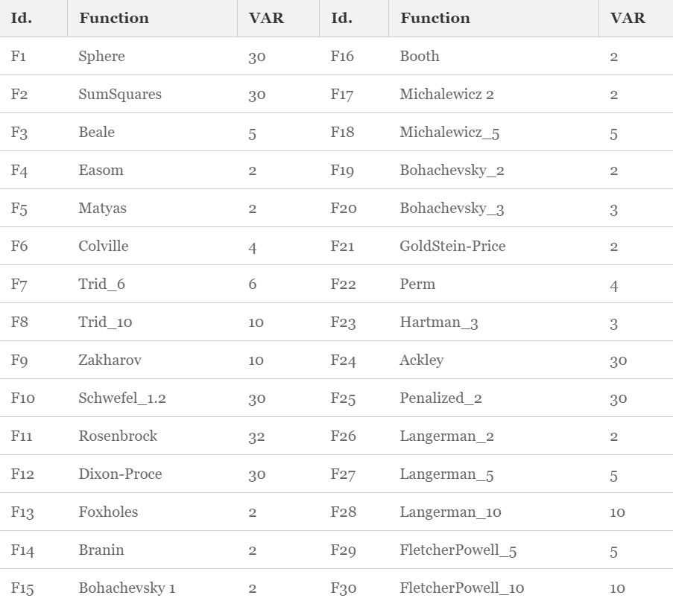

Slide 15
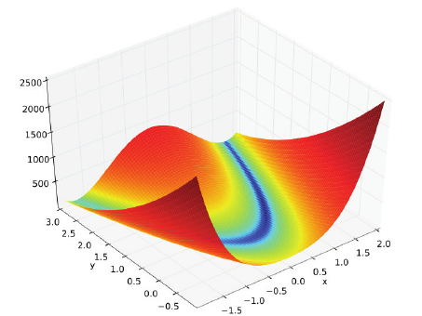
Rosenbrock function
Rosenbrock's valley / Rosenbrock's banana function
Find the global minimum

Slide 16
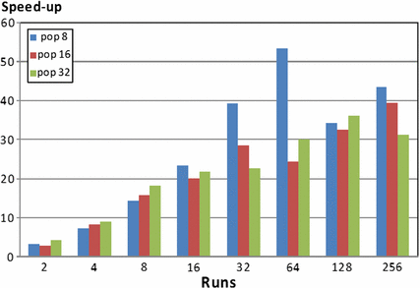
Rosenbrock function
Notes:
Speed up improved as population decreased – larger population is more accurate

Slide 17
Speed increase with the number of runs
Number of runs must be greater than number of stream multiprocessors
In some cases of less complex functions this may be up to 1024
Complex functions as low as 128 or 64
Performance depends on function

Slide 18
In conclusion-
The absolute value of the amount of variables of a function (j)
The absolute value of the amount of candidates of a function (k)
Less relevant than the ability to keep all stream multiprocessors fed with jobs
Thankyou for your time

Slide 19
References:
Chwastek, K. (2011) The applications of fixed-point theorem in optimisation problems in optimisation problems The applications of fixed-point theorem in optimisation problems. Archives of Electrical Engineering. 61 (2), pp.189-198.
Anon. (2008) Scicomp Accelerates Market Leading Derivative Pricing Software with NVIDIA CUDA . santa clara, 2008. Nvidia.
Jimeno-Morenilla, A., Jimeno-Morenilla, A., Sánchez-Romero, J.L., Migallón, H. and Mora-Mora, H. (28) Jaya optimization algorithm with GPU acceleration. The Journal of Supercomputing [online].
Smith, R. (2014) the NVIDIA GeForce GTX 980 Review: Maxwell Mark 2 Available from: https://www.anandtech.com/show/8526/nvidia-geforce-gtx-980-review/3 [Accessed 01/12/2018].

